Slide 1
Different Tree Data Structures for Different Problems

Slide 2
Data Structures
Data Structures have to be adapted for each problem:
A specific subset of operations
(Example: Search is needed, Insert is not)
A specific set of requirements or usage patterns
(Example: Search occurs frequently, Insert occurs rarely)
Special Data Structures
Hybrid data structures
Augmented data structures

Slide 3
Problem 1
Problem: Dictionary, where every key has the same probability to be searched for and the structure must be dynamic (inserts and deletes)
Solution: we have seen that we can use Balanced Binary Search Trees

Slide 4
Problem 2
Problem: Dictionary, where every key has a different, known probability to be searched for; the structure is not dynamic.
Example: A dictionary must contain words: bag, cat, dog, school. It is known that: school gets searched 40% of the time, bag 30% of the time, dog 20% of the time and cat 10% of the time.
The keys which are more frequent searched for must be near the root. Balancing for reducing height does not help here !
Solution: build the Optimal Binary Search Tree

Slide 5
Optimal BST Example
Balanced BST
0.1
Optimal BST
0.4
cat
school
0.3
0.2
0.3
bag
dog
bag
0.4
0.2
school
dog
0.1
cat
0.1 * 0 + 0.3*1+ 0.2* 1 + 0.4*2 = 1.3
0.4 * 0 + 0.3*1+ 0.2* 2 + 0.1*3 = 1.0

Slide 6
Building the Optimal BST
Cost of the tree: sum, for all nodes, of the cost of searching the node weighted with the probability of searching the node
The cost of searching a node: the depth of the node (distance from the root)
Optimal BST input data: a sorted set of keys and their probabilities
Optimal BST output: the BST containing all the given keys, that has the minimum cost of the tree from all trees that can be built from the given keys
Brute force solution: build all tree configurations that contain the n keys and see which is best => much too inefficient
Efficient solution: will be discussed later as one of the exercises for Dynamic Programming

Slide 7
Problem 3
Problem: A dictionary structure, used to store a dynamic set of words that may contain common prefixes.
Word=string of elements from an alphabet; alphabet=the set of all possible elements in the words
Solution:
We can exploit the common prefixes of the words, and associate the words(the elements of the set) with paths in a tree instead of nodes of a tree
Solution: Trie trees (Prefix trees, Retrieval trees)
Multipath trees
If the alphabet has N symbols, a node may have N children

Slide 8
Trie Tree Example
BAD
BAG
BAR
BART
BE
BY
BYTE
SEA
SEE
SEEN
SELL
SHE
B
S
A
E
E
H
Y
D
G
R
A
L
E
E
T
N
L
T
E

Slide 9
Trie Trees
A trie tree is a tree structure whose edges are labeled with the elements of the alphabet.
Each node can have up to N children, where N is the size of the alphabet.
Nodes correspond to strings of elements of the alphabet: each node corresponds to the sequence of elements traversed on the path from the root to that node.
The dictionary maps a string s to a value v by storing the value v in the node of s. If a string that is a prefix of another string in the dictionary is not used, it has nil as its value.
Possible implementation: a trie tree node structure contains an array of N links to child nodes (a link to a child node can be also nil) and a link to the current strings value (it can be also nil).

Slide 10
Trie Tree Example
B
S
E
Y
E
H
5
3
A
L
E
E
9
7
4
N
L
Dictionary: (Words with values):
BE = 5, BY =3,
SEA=9, SEE=7, SEEN=8,
SELL=2, SHE=4
8
2

Slide 11
Trie Trees
Usages:
Predictive text (autocomplete features)
In dictionary-based compression algorithms (LZW)
For further reading (optional only):
[Sedgewick], Algorithms, 4th ed, chapter 5.2

Slide 12
Problem 4
Problem: we need a data structure having features similar to the search trees (efficient search, insert, delete) but on the secondary storage (disk).
The amount of data handled is so large that it does not fit into the memory at once
First idea: store a BST in a file on disk:
Generalizes the representation of BST using arrays in memory

Slide 13
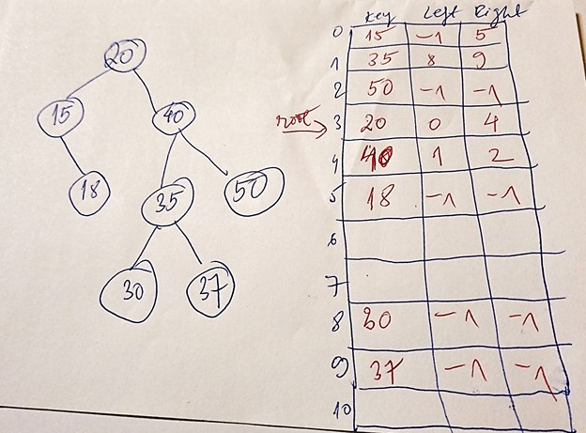
Storing a BST in an array
Array of records. Each record may store a node.
Use values of array indexes instead of pointers/references to children
Used as an alternative to dynamic memory allocation in safety critical systems

Slide 14
Storing a BST in a file?
Generalizes the representation of BST using arrays in memory
One Node is a fixed-size record, containing “key” and “left child”, “right child”. The “child pointers” are here offset values for random accesses (fseek) in the file
How traditional disks work:
Disks are slow, thus an efficient read/write happens only in bulk (several items at once, forming a page)
Some selected pages are read into memory, operated and written back onto disk if changed
=> searching in a BST-on-disk requires a fseek after each node -> bad performance

Slide 15
Problem 4 - Solution
Solution: Adapt the BST data structure to a balanced search tree that may contain in a node several keys, up to fill up a page => B-Trees (Bayer & McCreigh, 1971)

Slide 16
B-Tree General Structure
…
…
…
…
…
Every node has n keys and n+1 children.
All the leafs must be at the same depth.
The number of children of a node (n+1) is allowed to vary between
t<=n+1<=2t (Exception: the root may have less than t)
The value t is called the minimum degree of the B-tree
The value of t is chosen in concordance with the size of the disk page

Slide 17
B-Tree Node Structure
c₁ key₁ c₂ key₂ … key_{i-1} c_{i} key_{i} … c_{n} key_{n} c_{n+1}
…
…
ki
The keys in a node (page) are sorted:
key₁ < key₂ < … < key_{i-1} < key_{i} < … < key_{n}
For any key k_{i} stored in the subtree with root c_{i} we have
key_{i-1} < ki < key_{i}

Slide 18
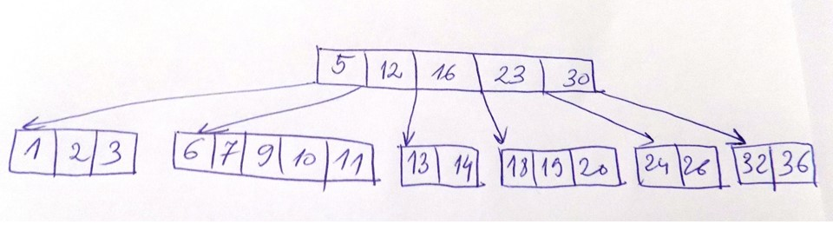
Example: B-Tree with t=3
Number of keys in a node: t-1<=n<=2*t-1 => between 2 and 5 keys (except the root, which can have less keys (1) if needed)
Number of children of a node: t<=n+1<=2*t => between 3 and 6 children
In this example, the tree has only 2 levels (height 2) but it could have any number of levels.

Slide 19
B-Trees – formal definition [CLRS]
A B-tree T is a rooted tree (whose root is T.root) having the properties:
Every node x has the following attributes:
x.n, the number of keys currently stored in node x,
the x.n keys themselves, x.key₁, x.key₂, …, x.key_{x.n}, stored in nondecreasing order, so that x.key₁ <= x.key₂ <= … <= x.key_{x.n}
x.leaf , a boolean value that is TRUE if x is a leaf and FALSE if x is an internal node.
Each internal node x also contains x.n+1 pointers x.c₁, x.c₂, … x.c_{x.n+1} to its children. Leaf nodes have no children, and so their c_{i} attributes are undefined.
The keys x.key_{i} separate the ranges of keys stored in each subtree: if k_{i} is any key stored in the subtree with root x.c_{i}, then k₁ <= x.key₁ <= k₂ <= x.key₂ <= … <= X.key_{x.n} <= k_{x.n+1}
All leaves have the same depth, which is the tree’s height h.
Nodes have lower and upper bounds on the number of keys they can contain. We express these bounds in terms of a fixed integer t >=2 called the minimum degree of the B-tree:
Every node other than the root must have at least t -1 keys. Every internal node other than the root thus has at least t children. If the tree is nonempty, the root must have at least one key.
Every node may contain at most 2t -1 keys. Therefore, an internal node may have at most 2t children.

Slide 20
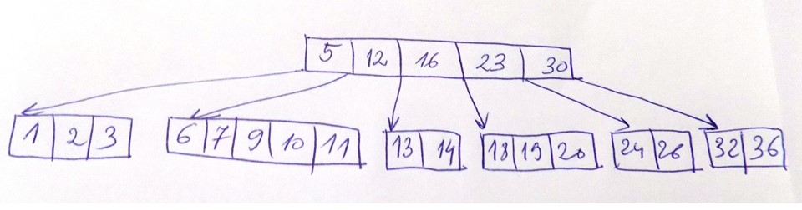
Example: B-Tree Search
The tree is traversed from top to bottom, starting at the root. At each level, the
search chooses the child pointer (subtree) which is between two key values that frame
the searched value. Binary search can be used within each node.
Example: if we search for value=19, starting at the root 16<19<23, thus we continue
the search in the subtree rooted in child 4.

Slide 21
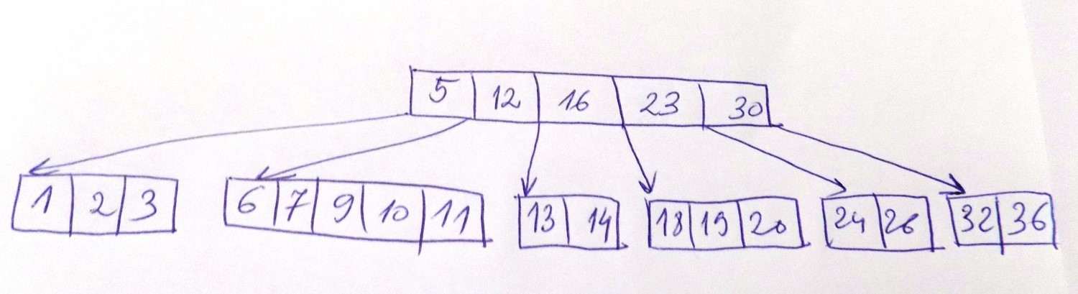
Example: B-Tree Insert
4
Insertion looks for the right leaf node where to insert the new key
Case 1: the leaf node found is not full (less than 2*t-1 keys)

Slide 22
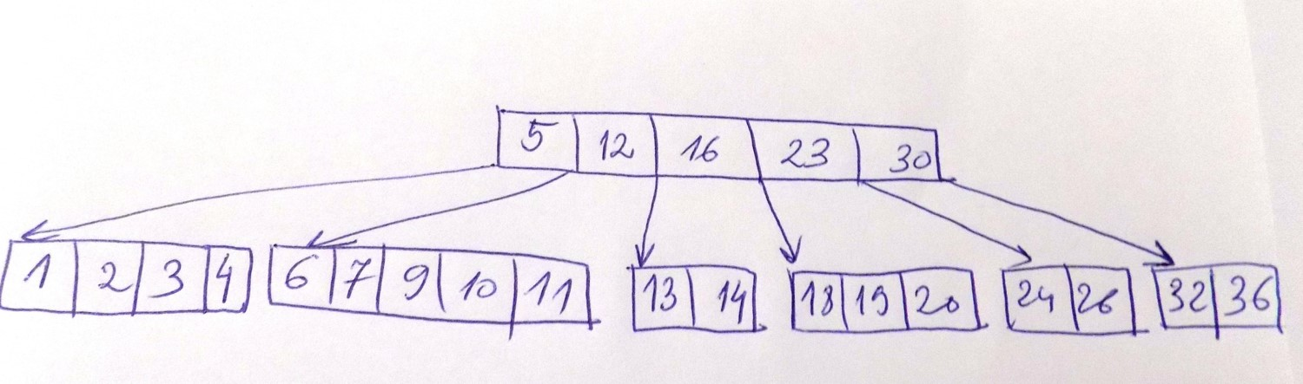
Example: B-Tree Insert
8
Insertion looks for the right leaf node where to insert the new key
Case 2: the leaf node found is full (has already 2*t-1 keys)

Slide 23
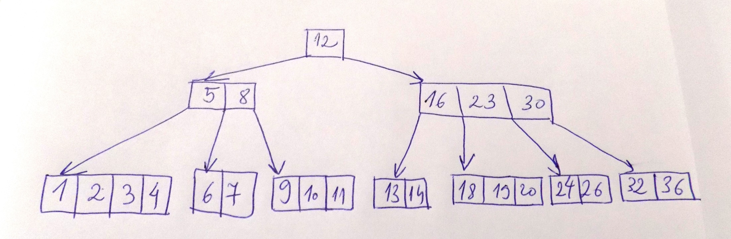
Example: B-Tree Insert
A full node is split into 2 nodes around its median key. The median key moves up to
its parent node. If the parent is also full, it will be split as well. In the worst case
we have to split full nodes all the way up to the root of tree and the tree increases
Its height, getting a new root.

Slide 24
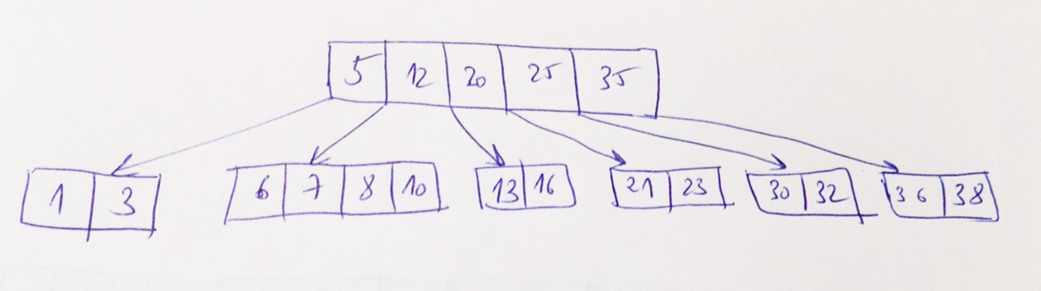
Example: Efficient B-Tree Insert
31
In order to be efficient, inserting a key into a B-tree should happen in a single pass
down the tree from the root to a leaf. To do so, we do not wait to ﬁnd out whether
we will actually need to split a full node in order to do the insertion. Instead, as we
travel down the tree searching for the position where the new key belongs, we split
each full node we come to along the way (including the leaf itself).
Thus whenever we want to split a full node y, we are assured that its parent is not full.
Still, it is possible that we are doing unnecessary root splits.

Slide 25
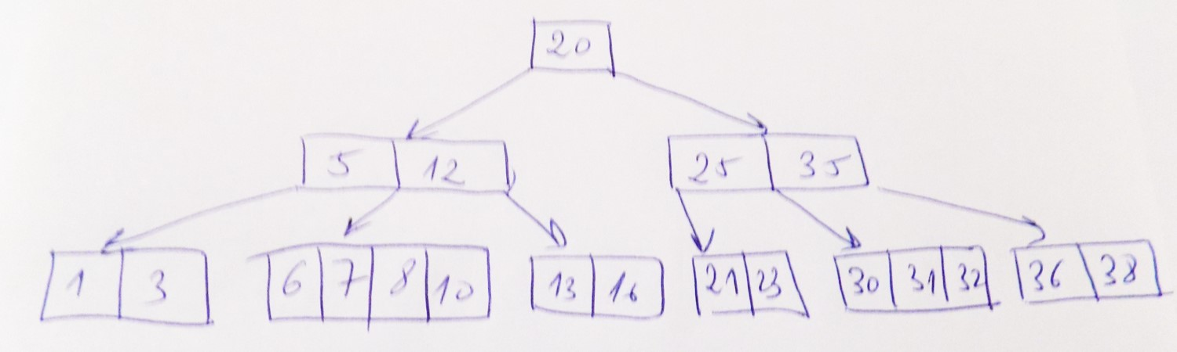
Example: Efficient B-Tree Insert

Slide 26
B-trees
Usages:
B-Trees are widely used for file systems and databases
For further reading (optional only): [CLRS] chapter 18

Slide 27
Problem 5
Problem: find another method for “balancing” BST, doing less rotations in case of Delete

Slide 28
Red-Black Trees or 2-3-4 Trees
Idea: Construct binary trees as a particular case of B-trees
2-3-4 Trees: actually B-trees of min degree 2
Nodes may contain 1, 2 or 3 keys
Nodes will have, accordingly, 2, 3 or 4 children
All leaves are at the same level

Slide 29
2-3-4 Trees Nodes
a
a b
<a
>a
<a
>a
and
<b
>b
a b c
<a
>a
and
<b
>b
and
<c
>c

Slide 30
Example: 2-3-4 Tree
8 13 17
1 6
11
15
22 25 27

Slide 31
Transforming a 2-3-4 Tree into a Binary Search Tree
A 2-3-4 tree can be transformed into a Binary Search tree (called also a Red-Black Tree):
Nodes containing 2 keys will be transformed in 2 BST nodes, by adding a red (“horizontal”) link between the 2 keys
Nodes containing 3 keys will be transformed in 3 BST nodes, by adding two red (“horizontal”) links originating at the middle keys

Slide 32
Example: 2-3-4 Tree into Red-Black Tree
8 13 17
1 6
11
15
22 25 27

Slide 33
Example: 2-3-4 Tree into Red-Black Tree
13
8
17
1
15
25
11
6
22
27
Colors can be moved from the links to the nodes pointed by these links

Slide 34
Red-Black Tree
13
8
17
1
15
25
11
6
22
27

Slide 35
Red-Black Trees
A red-black tree is a binary search tree with one extra bit of storage per node: its color, which can be either RED or BLACK.
By constraining the node colors on any simple path from the root to a leaf, red-black trees ensure that no such path is more than twice as long as any other, so that the tree is approximately balanced.

Slide 36
Red-black Tree Properties
Every node is either red or black.
The root is black.
T.nil is black.
If a node is red, then both its children are black. (Hence no two reds in a row on a simple path from the root to a leaf.)
For each node, all paths from the node to descendant leaves contain the same number of black nodes.

Slide 37
Heights of Red-Black Trees
Height of a node is the number of edges in a longest path to a leaf.
Black-height of a node x: bh(x) is the number of black nodes (including T.nil) on the path from x to leaf, not counting x. By property 5, black-height is well defined.

Slide 38
Height of Red-Black Trees
Theorem
A red-black tree with n internal nodes has height h <= 2 log (n+1).
Proof (optional only) : see [CLRS] – chap 13.1 .

Slide 39
Insert in Red-Black Trees
Insert node z into the tree T as if it were an ordinary binary search tree
Color z red.
To guarantee that the red-black properties are preserved, we then recolor nodes and perform rotations.
The only RB properties that might be violated are:
property 2, which requires the root to be black. This property is violated if z is the root
property 4, which says that a red node cannot have a red child. This property is violated if z’s parent is red.
There are 6 cases (3+3) for restoring the RB property by rotations and recoloring
(Further reading – optional only – [CLRS] chap 13])

Slide 40
Example : RB-INSERT
13
8
17
1
15
25
11
6
22
27
7

Slide 41
Example : RB-INSERT
13
8
17
6
15
25
11
1
7
22
27

Slide 42
AVL vs RB
 | AVL | RB
Max Height | 1.44 log n | 2 log n
INSERT | O(log n) | O(log(n)
Rotations at Insert | O(1) | O(1)
DELETE | O(log n) | O(log n)
Rotations at Delete | O(log n) | O(1)
Used in collection libraries |  | Java’s TreeSet, TreeMap C++ STL set, map .NET SortedSet

